Slide 1
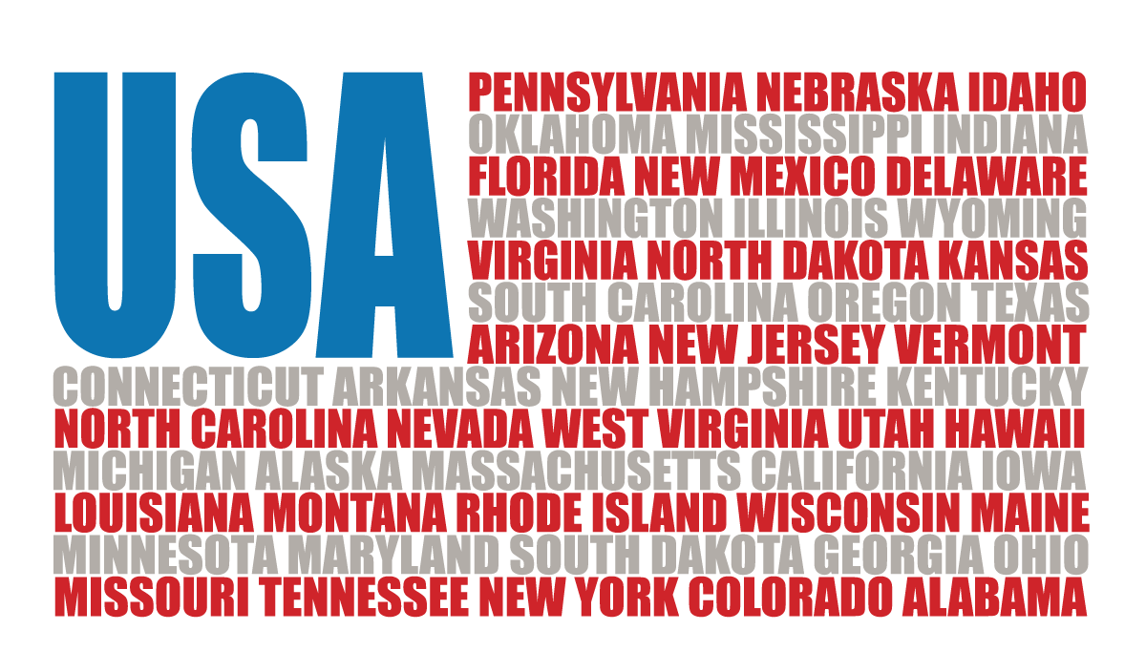
Convention of States Project
Texas Convention of States
Legislative Session V

Slide 2
Political Reality
The Opposition
The Competition
Wolves in Sheep’s Clothing
Pitfalls and Personalities
Possible Tactics
Questions

Slide 3
The Opposition - 1
The John Birch Society (JBS)
Small
Influential at the Local Level
Irrelevant at the Capitol
Main Argument - Nullification
Members You’ll See – Davis Ford

Slide 4
The Opposition - 2
The Texas Eagle Forum (TEF)
Leadership Turnover
Anti-Article V Lobbyist Left
Main Argument: Runaway Convention
Spin-Off Organization: Texas Center for Protecting the Constitution
Member You’ll See – Pat Carlson
Pat Carlson House Testimony

Slide 5
The Opposition - 3
Libertarian Fringe
Not an Organized Group
Main Arguments:
Nullification
Jury Nullification
Runaway Convention
People You’ll See:
Barbara Harless
Michael Badnarik
Shirley Spellerberg

Slide 6
The Opposition - 4
Fearmongers
National Association of Gun Rights (NAGR)
Main Argument:
Fear – You’ll Lose Your 2nd Amendment Rights
Tactics
Robo-Calls – From Out-of-State
Motivation
Fundraising
People You May See
Chris McNutt

Slide 7
The Opposition - 5
Fearmongers
Campaign For Liberty (CFL)
Main Argument:
Fear – Runaway Convention
Run By George Soros
Tactics
Robo-Calls – From Out-of-State
Motivation
Fundraising
People You May See
Byron Schirmbeck

Slide 8
The Opposition - 6
Our Response
Always Be Nice – Some (especially TEF) can be won over
They are Not a Threat
The Less You Mention Them, the Better
Don’t Hesitate to Adapt Your Testimony on the Fly (House Hearings)

Slide 9
The Competition - 1
The Madison Coalition
Advocates for the Countermand Amendment
Leadership: Roman Buhler
Amendment Proposal– Same Amendment as Mentioned by CATO Institute (Congress Proposes Constraint Amendment)
The Compact for America
Advocates for a Balanced Budget Amendment
Leadership: Nick Dranias
Amendment Proposal is Germane Under Our Application

Slide 10
The Competition - 2
The Balanced Budget Amendment Task Force (BBA)
Advocates for a Balanced Budget Amendment
Leadership: David Biddulph
Key Lobbyist: David Guldenschuh
Amendment Proposal Is Germane Under Our Application
U.S. Term Limits
Advocates for Term Limits on Congress
Pushing for Congress to Initiate the Proposed Amendment
Amendment Proposal is Germane Under Our Application
People You May See:
Brendan Steinhauser

Slide 11
The Competition - 3
Texas Nationalist Movement (TNM)
Advocates for Secession
Leadership: Nate Smith, Daniel Miller
Supported by Raging Elephants Radio (RER)
Secession is Extra-Constitutional

Slide 12
The Competition - 4
Our Response
Always Be Nice
Firmly Decline ANY Offer From Them
Do Not Take a Flyer, Certainly Not A Button
Avoid Any Appearance of COS Support for Them
Do Not Advocate For Them as a COS Supporter
They are A Threat
Their Applications/Presence Cause Confusion
They Wish to Capitalize on OUR Grassroots – They Want to Use YOU and Your Labor – THEFT!
They Are All Elitist: No Grassroots Support

Slide 13
Wolves in Sheep’s Clothing - 1
Wolf PAC – Free & Fair Elections
Advocates to Overturn the SCOTUS Citizen’s United Decision – Limit Campaign Contributions
Sponsor: George Soros
Texas Lobbyist: Todd Jagger
Look for @wolf-pac.com email addresses
Amendment Proposal is NOT Germane Under Our Application

Slide 14
Wolves in Sheep’s Clothing - 2
Our Response
Official COS Position is Strong Opposition
Be Wary of Wolf PAC Members Among Our Supporters/Leaders
Leverage Their Legislative Supporters
They Support the Article V Process!!

Slide 15
Pitfalls and Personalities - 1
Running Out the Clock (the Calendar)
We (State Leadership) Will Keep an Internal Calendar to Trigger Calls to Action
Promoting the Whip Count
We Will Keep our Internal Whip Count Closely Held
Overconfidence
We Don’t Know What We Don’t Know
The Only Count that Matters is a Vote

Slide 16
Pitfalls and Personalities - 3
Calendars Committee
We Will Work Those Members Districts Hard!
The Most Difficult to Read Step in the Process
We Will Closely Monitor

Slide 17
Possible Tactics
What If Things “Go South”?
Level of Magnitude Response
Alert Our Chamber Sponsor
Alert Governor Abbot and/or Lt. Gov. Patrick
District Call to Action
Statewide Call to Action
National Call to Action
Expect Radio Ads Before Key Actions

Slide 18
Questions?

