Slide 1
Convention of States Project
Texas Convention of States
Legislative Session III

Slide 2
Practical Advice in District
Keep Contact with Your Legislators
Keep Contact with Your Supporters
Grow Your Grassroots!
Keep Track of Our Progress Online
Questions
Notes:
Let your audience know in advance where you’re taking them

Slide 3
Keep Contact with Your Legislators
Continue Communication with Legislative Staff
In Person in District Office (1-2 times month)
Weekly Contact with Austin Office – Find the COS Staffer (CoS, LD, Policy Advisor, Etc.)
Meet Your Legislator in District – Especially Early in Session (MLK Holiday, President’s Day)
Promote Your Legislator’s Appearances with Your COS Volunteers – Be “omnipresent”
Notes:
Let your audience know in advance where you’re taking them

Slide 4
Keep Contact with Your Supporters
Send regular email blast updates/reports
Provide status of our resolution – how is it progressing
Provide Notice of Hearings, Floor Votes
Be ready for Calls to Action
Start Identifying Your Reliable Volunteers Now
Build Your Own “Quick Response Team” in Your District – Even 5-10 Volunteers in a District Can Make Significant Impact
You Are Their Source of Information
Notes:
Let your audience know in advance where you’re taking them

Slide 5
Grow Your Grassroots! - 1
Session is a Great Time to Grow Support
Party Activists Especially Are Paying Attention to Legislative Activity in Austin
Offer to Give Regular Reports at Party/Liberty Functions
You Have the Inside Scoop – You Will Be the “Go-To” Contact, Even for Long Time Party Veterans/Leaders
Keep Giving Presentations, Explaining the Convention of States
Notes:
Let your audience know in advance where you’re taking them

Slide 6
Grow Your Grassroots! - 2
Session is a Great Time to Grow Support
Consider Hosting Watch Parties for Hearings and Floor Votes – Every Hearing and Floor Vote is Livestreamed
Help Coordinate Volunteers/Supporters Making a Trip to the Capitol – Participation at the Capitol is the Most Powerful Expression of Grassroots Strength.
Notes:
Let your audience know in advance where you’re taking them

Slide 7
Keep Track of Our Progress Online
Bookmark the Texas Legislature Online Website
http://www.capitol.state.tx.us/
Create An Account
Create Alerts (Automatic Email Notification)
Bookmark the Video Broadcast Sites
http://www.house.state.tx.us/video-audio/
http://www.senate.state.tx.us/bin/live.php

Slide 8
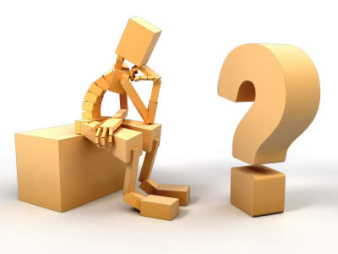
Questions?

