Slide 1
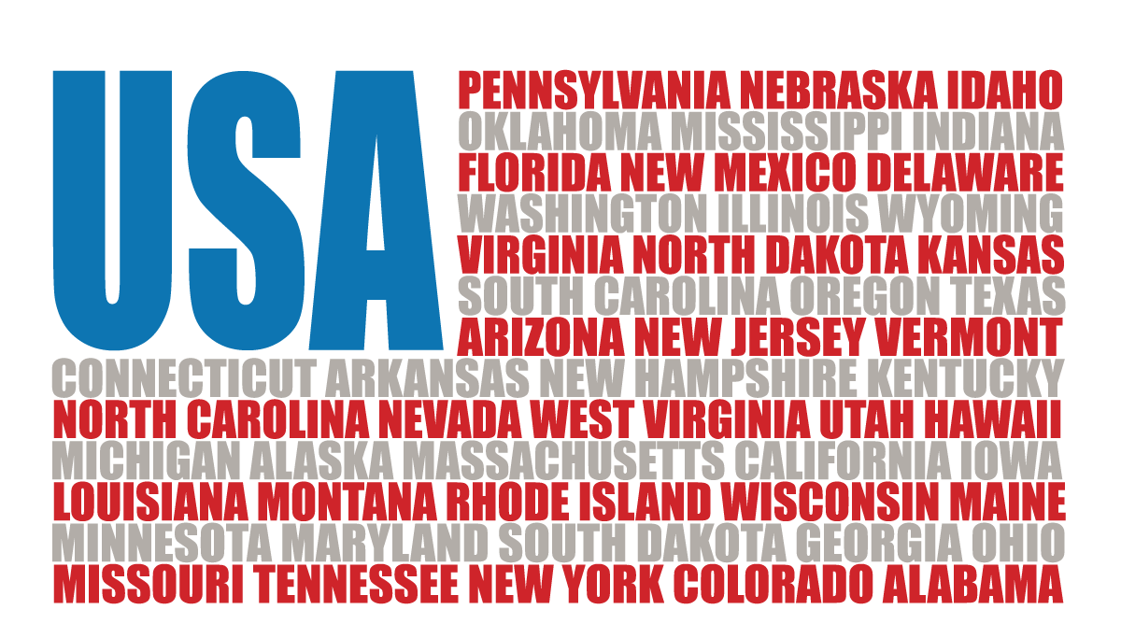
Convention of States Project
Texas Convention of States
Legislative Session I

Slide 2
Legislative Session Training
Introduction and Overview
Texas Legislative Process
Practical Advice (In District, at the Capitol)
Growing Your Grassroots
Advocating During Session
Hearing Testimony
Tracking Bills and the Calendar
Political Reality – Personalities and Process
Notes:
Let your audience know in advance where you’re taking them

Slide 3
Agenda – Legislative Session I
Legislative Overview – Cradle to Grave/Heaven
The Components, and the Dynamics, of Legislation
Overview Convention of States
Questions
Notes:
Let your audience know in advance where you’re taking them

Slide 4
If Only It Was This Easy!
Notes:
Schoolhouse Rock: I’m Just a Bill!

Slide 5
Sometimes We Think It’s Like This…
Notes:
Plate Spinning… the same trick, over and over and over

Slide 6
But Really, It’s Like This!!!
Notes:
Juggling – Chainsaw, Bowling Ball, Apple
Same skill (juggling), different elements

Slide 7
Legislative Overview… Cradle to Grave/Heaven
Seek Your Sponsor(s)
Strategic Sponsor
Champion Sponsor
Announce Your Sponsor(s)
Announce Filing/Pre-Filing
Plan/Schedule COS Rally/Advocacy Day
Print petitions for Committee Members
Prepare for Committee/Subcommittee Hearing/Vote
After passing one chamber, repeat previous two steps
Announce Passage of Resolution!!!
Notes:
From inception of the process to it’s death, or success!

Slide 8
The Components, and Dynamics, of Legislation
Policy
The Legislation Itself, Addresses a Problem
Process
How Does It Become a Law (or Resolution)?
What Can I Do to Influence the Process?
Political Reality
What Process Factors Do I Consider?
What About Personalities?
Notes:
Policy – The actual legislation

Slide 9
Subject Matter Application
Limited to proposing amendments to the Constitution of the United States that:
1
Impose Fiscal Restraints on the Federal Government
2
Limit the Power and Jurisdiction of the Federal Government
3
Limit the terms of office for federal officials and for members of Congress
Notes:
Emphasize the difference between a specific amendment resolution (e.g., Balanced Budget Amendment, Term Limits) and our Subject Matter Application. This is a great setup for Governor Abbott’s nine model subjects – our resolution is the framework in which the Governor’s ideas fit

Slide 10
Texas Plan and COS Application
1
Fiscal Restraints
2
Limit Power
3
Term Limits
II. Balanced Budget
I. Commerce Clause
Not in the Texas Plan, but…
Governor Abbott, on at least four very public occasions:
TCCRI speech
Texas State GOP Keynote
Mark Levin Show
COS Advocacy Forum
Named Term Limits FIRST when speaking of possible amendment proposals at a Convention of States
III. Administrative Agencies NOT create Federal Law
The Texas Plan is Governor Abbott’s proposal of nine model subjects to be discussed at the Convention of States. It is not intended to be an exhaustive list!
IV - Prohibit administrative agencies—and the unelected bureaucrats that staff them—from preempting state law
VI - Require a seven-justice super-majority vote for SCOTUS decisions that invalidate a democratically enacted law
VIII - Give state officials the power to sue in federal court when federal officials overstep their bounds – enumerates interposition!
III - Prohibit administrative agencies—and the unelected bureaucrats that staff them—from creating federal law
V - Allow a two-thirds majority of the States to override a U.S. Supreme Court decision – enumerates nullification power!
VII - Limit the federal government to the powers expressly delegated to it in the Constitution – Put Teeth in the 10th Amendment
IX - Allow a two-thirds majority of the States to override a federal law or regulation – enumerates nullification power!
II - Require Congress to balance its budget (Fiscal Restraint)
I - Prohibit Congress from regulating activity that occurs wholly within one State – Commerce Clause
IV. Admin Agencies NOT preempt State Law
V. 2/3 States Majority override SCOTUS
VI. Super majority SCOTUS decisions
VII. Express Powers Only
VIII. Enumerated Power to sue in Federal Court
IX. 2/3 State Override of Federal Law
Notes:
Consider spending a little bit of time with proposals #1, 5, 9.
The commerce clause is one of the most abused clauses in the Constitution. Proposals 5 and 9 both define how the states can collectively nullify SCOTUS rulings or federal law
Proposal #8 – a great example showing off Governor Abbott’s chops as AG – interposition, provides a “right of standing before the federal court” to every citizen who is represented by the state government

Slide 11
So, How Do These Get Proposed?
Notes:
This is especially helpful for legislators – make sure they are attentive for this 45 second video. They will relate to what Professor Barnett says, and they may well make the connection to how, and why, a convention is necessary.

Slide 12
Questions?

